Slide 1

Text Classification (Ensemble Method) Unity is strength, division is weakness.
.
Notes:
The Objective of this research
To forecast the construction of SFHs in United States, so that it guide construction business community about where to invest ahead of time. Past data can be used analyze complex patterns in SFHs construction across united states (US)
Once we get the prediction, now it is important to know the optimal locations where construction company build plants

Slide 2
What is CSO Classifier?
Problem Definition
The CSO Classifier is a novel application that takes as input the text from abstract, title, and keywords of a research paper and outputs a list of relevant concepts from CSO. It consists of two main components: (i) the syntactic module and (ii) the semantic module.
CSO Miss-classification
There is a problem of miss-classification in CSO Classifier. Consider terms such as
‘random processes', 'gaussians', 'communication', 'identity', 'stochastic processes', 'signal to noise ratio', 'mathematical transformations', 'random variables‘, 'mean square‘
Above should not be classified as Technology terms
I have solved this problem using ML + NLP + Fuzzy Logic
.
Notes:
The Objective of this research
To forecast the construction of SFHs in United States, so that it guide construction business community about where to invest ahead of time. Past data can be used analyze complex patterns in SFHs construction across united states (US)
Once we get the prediction, now it is important to know the optimal locations where construction company build plants

Slide 3
.
Agenda
.
Proposed Solution
Natural Language
Fuzzy Match
Machine Learning
Working of System
Notes:
The Objective of this research
To forecast the construction of SFHs in United States, so that it guide construction business community about where to invest ahead of time. Past data can be used analyze complex patterns in SFHs construction across united states (US)
Once we get the prediction, now it is important to know the optimal locations where construction company build plants

Slide 4
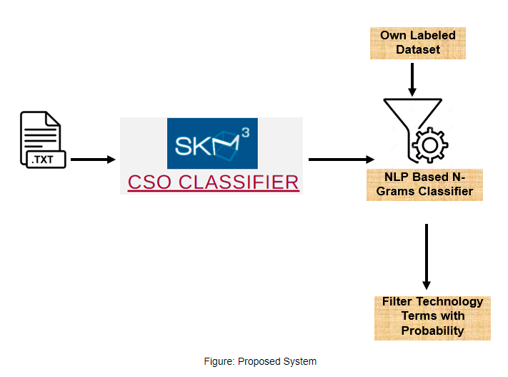
.
Proposed Solution
.
Machine Learning
NLP
Fuzzy Match
Notes:
The Objective of this research
To forecast the construction of SFHs in United States, so that it guide construction business community about where to invest ahead of time. Past data can be used analyze complex patterns in SFHs construction across united states (US)
Once we get the prediction, now it is important to know the optimal locations where construction company build plants

Slide 5
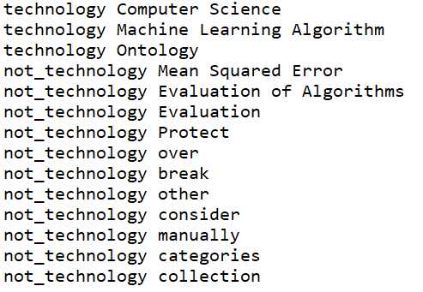
.
Implementation
.
For implementation of proposed system, we need labelled dataset
I manually labelled terms (output of CSO Classifier)
852 was not_technology terms and 362 was technology terms
Notes:
The Objective of this research
To forecast the construction of SFHs in United States, so that it guide construction business community about where to invest ahead of time. Past data can be used analyze complex patterns in SFHs construction across united states (US)
Once we get the prediction, now it is important to know the optimal locations where construction company build plants

Slide 6

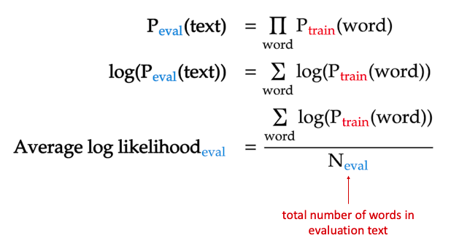
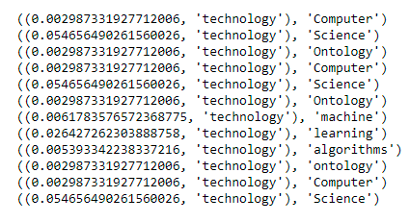
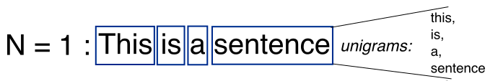
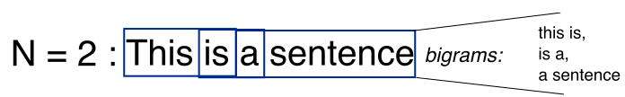
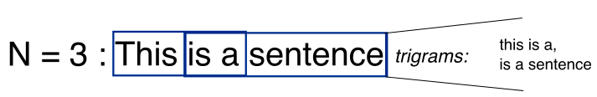
Lets first understand, what is N-Gram (it is basically the splitting of sentence/ word)
NLP Based N-Gram Model
.
This is actual mathematics behind the scene
N-Gram Model returns term with Class and Probability
Give us the probability of term being a tech or not tech term
This required large number of labelled terms, so we use this as a feature for ML
As discussed the model alone is weak (50% Accurate)
I have used same concept but not on word level (actually on character level), because we have keywords and might be short phrases.
We are using this with others (will be discussed later)
Notes:
The Objective of this research
To forecast the construction of SFHs in United States, so that it guide construction business community about where to invest ahead of time. Past data can be used analyze complex patterns in SFHs construction across united states (US)
Once we get the prediction, now it is important to know the optimal locations where construction company build plants

Slide 7
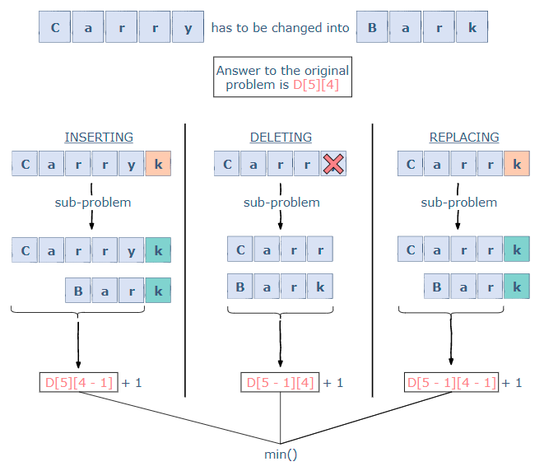
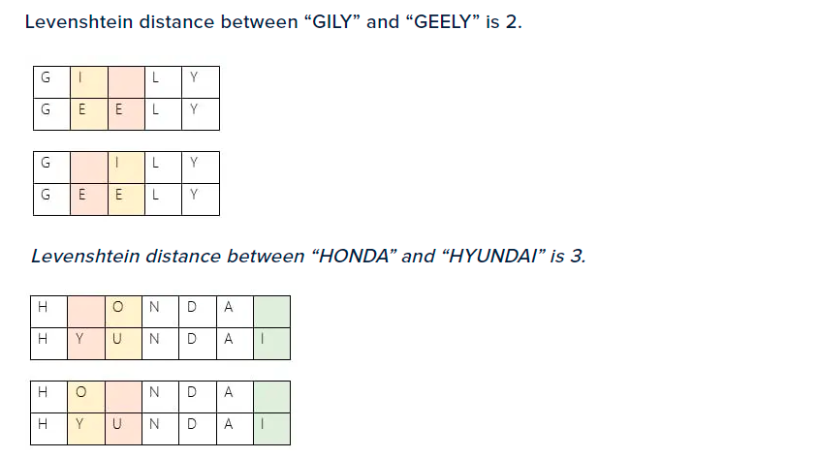
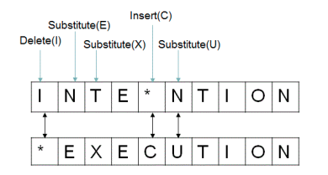
.
Fuzzy Matching
For the word kelo, the possible prefixes are k, ke, kel, and kelo for a total of four prefixes. For the word hello, the prefixes are h, he, hel, hell, and hello for a total of five prefixes. The distance matrix calculates the distance between all prefixes in the two words.
Starting with the first prefix in the word kelo which is k, we'll compare it to all five prefixes in the word hello. The first one will be h. What is the Levenshtein distance between k and h? Because all we need to do is substitute the character k by h, the distance is 1.
.
Fuzzy Matching is the matching of terms with technology terms using fuzzy logic (Deep character level matching)
This metric give us score between 0 (not matched) and 100 (Matched)
I use this to calculate the match of term with Technology
Notes:
The Objective of this research
To forecast the construction of SFHs in United States, so that it guide construction business community about where to invest ahead of time. Past data can be used analyze complex patterns in SFHs construction across united states (US)
Once we get the prediction, now it is important to know the optimal locations where construction company build plants

Slide 8
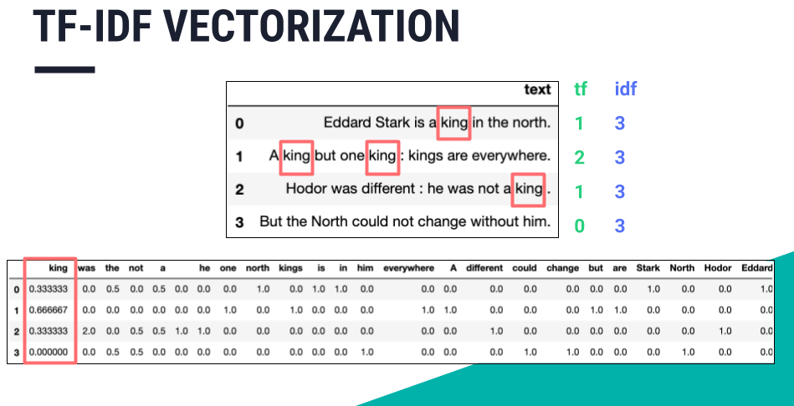
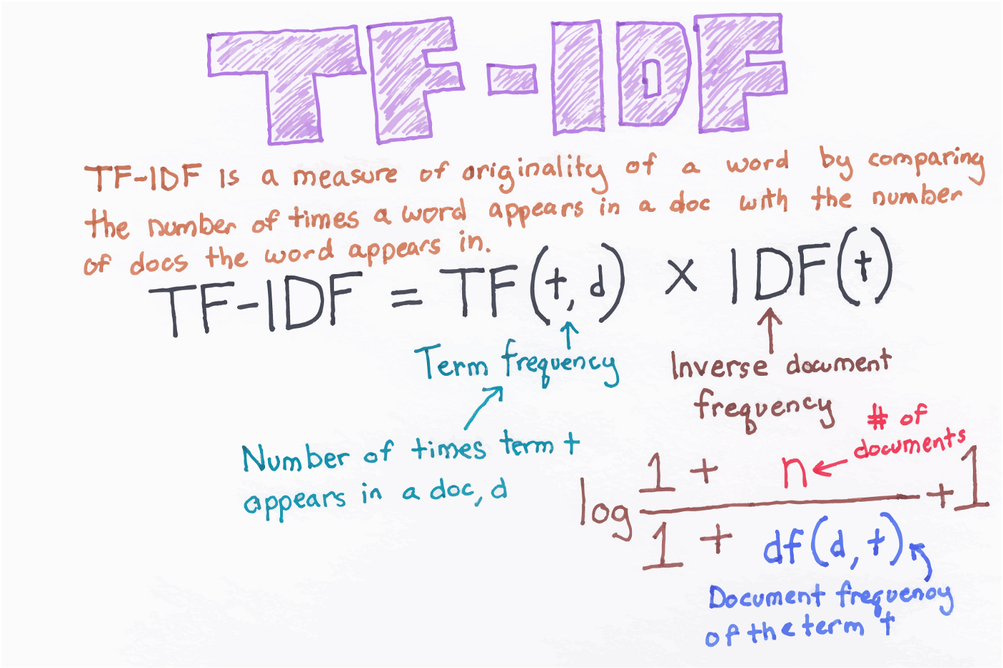
.
TFIDF - NLP
.
In information retrieval, TF–IDF, short for term frequency–inverse document frequency, is a numerical statistic that is intended to reflect how important a word is to a document in a collection or corpus. It is often used as a weighting factor in searches of information retrieval, text mining, and user modeling.
The word “king” appear 1 times in sentence 1 (TF) and there are total 3 sentences where the word “king” (1/3 IDF) appear. TFIDF will be 1*(1/3) = 0.33
I have used this to extract features for machine learning
Notes:
The Objective of this research
To forecast the construction of SFHs in United States, so that it guide construction business community about where to invest ahead of time. Past data can be used analyze complex patterns in SFHs construction across united states (US)
Once we get the prediction, now it is important to know the optimal locations where construction company build plants

Slide 9
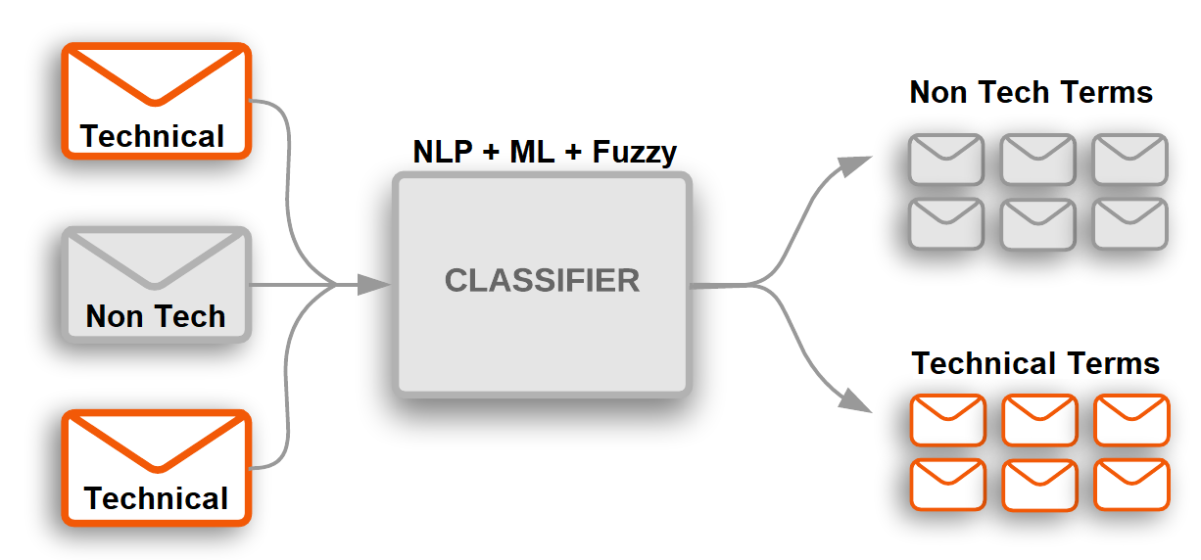
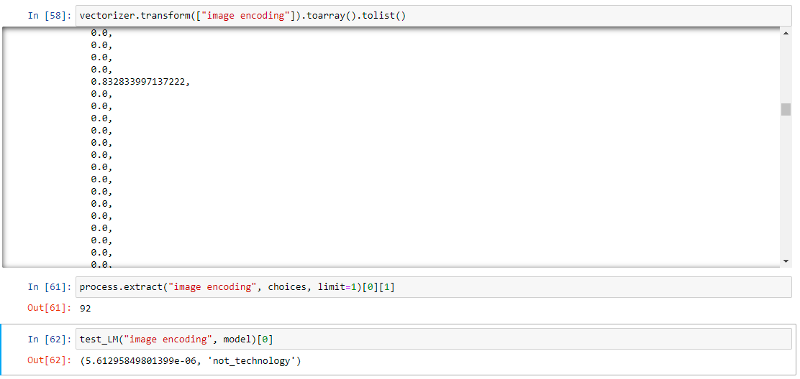
We have extracted TF-IDF features from the labelled dataset
System Implementation
.
TF-IDF Calculation
Then we calculate the probability of each term being a Technology term using N-Gram Natural Language Based Model
Similarly, for each labelled term, we calculate the relationship to Technology term using Fuzzy Match technique (this give score between 0 and 100)
Matching of this term to Technology
Classification = TFIDF + N-Gram Score + Fuzzy Match Score
The problem, now became text classification
Probability of this term being aTechnology
Notes:
The Objective of this research
To forecast the construction of SFHs in United States, so that it guide construction business community about where to invest ahead of time. Past data can be used analyze complex patterns in SFHs construction across united states (US)
Once we get the prediction, now it is important to know the optimal locations where construction company build plants

Slide 10
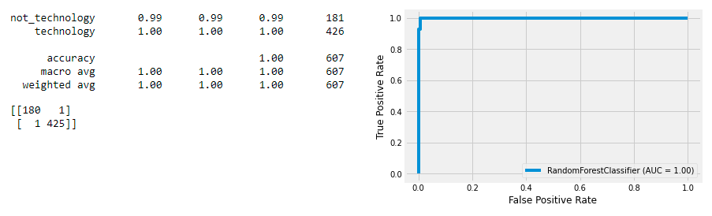
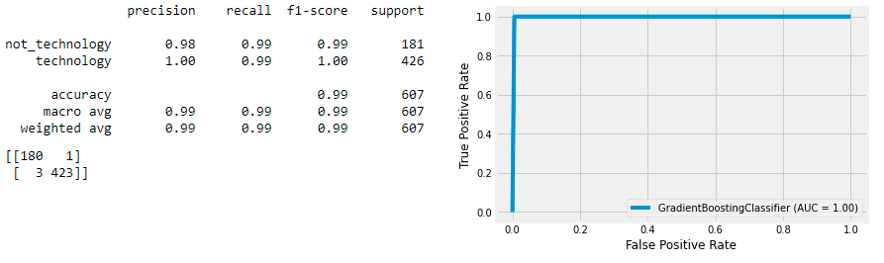
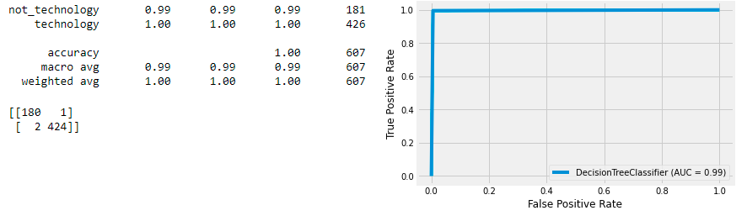
Decision Tree Classifier
Models and Performance
.
Random Forest Classifier
Gradient Boosting Classifier
All the models are performing up to 99.99% Accurate
Notes:
The Objective of this research
To forecast the construction of SFHs in United States, so that it guide construction business community about where to invest ahead of time. Past data can be used analyze complex patterns in SFHs construction across united states (US)
Once we get the prediction, now it is important to know the optimal locations where construction company build plants

Slide 11
Machine Learning State of the Art Algorithms are successfully used to predict whether term, whether it is Technical or Non Technical. This system will be used to assist CSO Classifier, the output of which will be passed through proposed system. The proposed system is capable of classifying terms up to 99.99% Accuracy. System can be made more effective by having larger labelled dataset.
Conclusion
.
Notes:
The Objective of this research
To forecast the construction of SFHs in United States, so that it guide construction business community about where to invest ahead of time. Past data can be used analyze complex patterns in SFHs construction across united states (US)
Once we get the prediction, now it is important to know the optimal locations where construction company build plants

Slide 12

Conclusion
i
Notes:
The Objective of this research
To forecast the construction of SFHs in United States, so that it guide construction business community about where to invest ahead of time. Past data can be used analyze complex patterns in SFHs construction across united states (US)
Once we get the prediction, now it is important to know the optimal locations where construction company build plants

